Slide 1
HYDRAULICS & HYDRAULIC MACHINES

Slide 2
Unit 5:
PELTON WHEEL

Slide 3
Learning Outcome
In this unit, you will learn
Introduction to turbines
Classification of turbines
Heads and efficiencies of turbines
Pelton wheel components
Working principle of Pelton wheel

Slide 4
Hydraulic machinery
Turbine is a device that extracts energy from a fluid (converts the energy held by the fluid to mechanical energy)
Pumps are devices that add energy to the fluid (e.g. pumps, fans, blowers and compressors).

Slide 5
Turbines
Hydro electric power is the most remarkable development pertaining to the exploitation of water resources throughout the world
Hydroelectric power is developed by hydraulic turbines which are hydraulic machines.
Turbines convert hydraulic energy or hydro-potential into mechanical energy.
Mechanical energy developed by turbines is used to run electric generators coupled to the shaft of turbines
Hydro electric power is the most cheapest source of power generation.

Slide 6
Turbines
J.V. Poncelet first introduced the idea of the development of mechanical energy through hydraulic energy
Modern hydraulic turbines have been developed by L.A. Pelton (impulse), G. Coriolis and J.B. Francis (reaction) and V Kaplan (propeller)

Slide 7
Turbines

Slide 8
Classification of turbines
Turbines can be classified on the basis of:
Head and quantity of water available
Hydraulic action of water
Direction of flow of water in the runner
Specific speed of turbines

Slide 9
Classification of turbines
Based on head and quantity of water
  According to head and quantity of water available, the turbines can be classified into
  a) High head turbines
  b) Medium head turbines
  c) Low head turbines
  a) High head turbines
  High head turbines are the turbines which work under heads more than 250m. The quantity of water needed in case of high head turbines is usually small. The Pelton turbines are the usual choice for high heads.

Slide 10
Classification of turbines
Based on head and quantity of water
  b) Medium head turbines
  The turbines that work under a head of 45m to 250m are called medium head turbines. It requires medium flow of water. Francis turbines are used for medium heads.
  c) Low head turbines
  Turbines which work under a head of less than 45m are called low head turbines. Owing to low head, large quantity of water is required. Kaplan turbines are used for low heads.

Slide 11
Classification of turbines
Based on hydraulic action of water
  According to hydraulic action of water, turbines can be classified into
  a) Impulse turbines
  b) Reaction turbines
  a) Impulse turbines
  If the runner of a turbine rotates by the impact or impulse action of water, it is an impulse turbine.
  b) Reaction turbines
  These turbines work due to reaction of the pressure difference between the inlet and the outlet of the runner.

Slide 12
Classification of turbines
Based on direction of flow of water in the runner
  Depending upon the direction of flow through the runner, following types of turbines are there
  a) Tangential flow turbines
  b) Radial flow turbines
  c) Axial flow turbines
  d) Mixed flow turbines
  a) Tangential flow turbines
  When the flow is tangential to the wheel circle, it is a tangential flow turbine. A Pelton turbine is a Tangential flow turbine.

Slide 13
Classification of turbines
Based on direction of flow of water in the runner
  b) Radial flow turbines
  In a radial flow, the path of the flow of water remains in the radial direction and in a plane normal to the runner shaft. No pure radial flow turbine is in use these days.
  c) Axial flow turbines
  When the path of flow water remains parallel to the axis of the shaft, it is an axial flow turbine. The Kaplan turbine is axial flow turbine
  d) Mixed flow turbines
  When there is gradual change of flow from radial to axial in the runner, the flow is called mixed flow. The Francis turbine is a mixed flow turbine.

Slide 14
Classification of turbines
Based on specific speed of turbines
  Specific speed of a turbine is defined as the speed of a geometrically similar turbine which produces a unit power when working under a unit head.
  The specific speed of Pelton turbine ranges between 8-30, Francis turbines have specific speed between 50-250, Specific speed of Kaplan lies between 250-850.
Based on disposition of shaft of runner
  Usually, Pelton turbines are setup with horizontal shafts, where as other types have vertical shafts.

Slide 15
Heads, Losses and Efficiencies of Hydraulic Turbines
Heads
These are defined as below:
(a) Gross Head: Gross or total head is the difference between the headrace level and the tail race level when there is no flow.
(b) Net Head: Net head or the effective head is the head available at the turbine inlet. This is less than the gross head, by an amount, equal to the friction losses occurring in the flow passage, from the reservoir to the turbine inlet.

Slide 16
Heads, Losses and Efficiencies of Hydraulic Turbines
Losses
Various types of losses that occur in a power plant are given below:
(a) Head loss in the penstock: This is the friction loss in the pipe of a penstock.
(b) Head loss in the nozzle: In case of impulse turbines, there is head loss due to nozzle friction.
(c) Hydraulic losses: In case of impulse turbines, these losses occur due to blade friction, eddy formation and kinetic energy of the leaving water. In a reaction turbine, apart from above losses, losses due to friction in the draft tube and disc friction also occur.

Slide 17
Heads, Losses and Efficiencies of Hydraulic Turbines
(d) Leakage losses: In case of impulse turbines, whole of the water may not be striking the buckets and therefore some of the water power may go waste. In a reaction turbine, some of the water may be passing through the clearance between the casing and the runner without striking the blades and thus not doing any work. These losses are called leakage losses.
(e) Mechanical losses: The power produced by the runner is not available as useful work of the shaft because some power may be lost in bearing friction as mechanical losses.
f) Generator losses: Due to generator loss, power produced by the generator is still lesser than the power obtained at the shaft output.

Slide 18
Heads, Losses and Efficiencies of Hydraulic Turbines
Efficiencies
Various types of efficiencies are defined as under:
(a) Hydraulic efficiency: It is the ratio of the power developed by the runner to the actual power supplied by water to the runner. It takes into account the hydraulic losses occurring in the turbine
η_{h} = Runner output / Actual power supplied to runner
= Runner output / (ρQgH)
Where, Q = Quantity of water actually striking the runner blades
H = Net head available at the turbine inlet

Slide 19
Heads, Losses and Efficiencies of Hydraulic Turbines
Efficiencies
(b) Volumetric efficiency: It is the ratio of the actual quantity of water striking the runner blades to the quantity supplied to the turbine. It takes into account the volumetric losses.
Let ∆Q = Quantity of water leaking or not striking the runner blades
η_{v} = Q / (Q+ ∆Q)
(c) Mechanical efficiency: The ratio of the shaft output to the runner output is called the mechanical efficiency and it accounts for the mechanical losses.
η_{m} = Shaft output / Runner output

Slide 20
Heads, Losses and Efficiencies of Hydraulic Turbines
Efficiencies
(d) Overall efficiency: Ratio of shaft output to the net power available at the turbine inlet gives overall efficiency of the turbine
η_{m} = Shaft output / Net power available
Thus all the three types of losses, mechanical, hydraulic and volumetric have been taken into account.

Slide 21
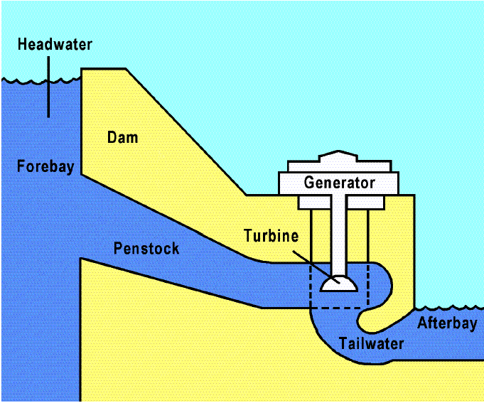
Hydropower to Electric Power
Electrical
Energy
Potential
Energy
Electricity
Kinetic
Energy
Mechanical
Energy

Slide 22
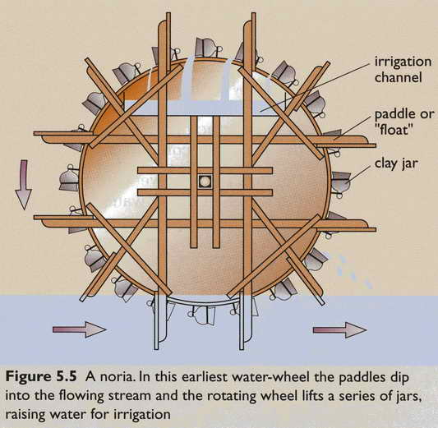
Early Irrigation Waterwheel

Slide 23
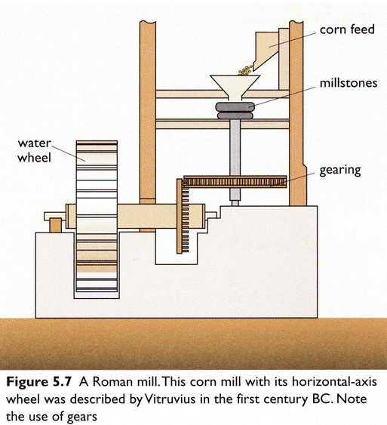
Early Roman Water Mill

Slide 24
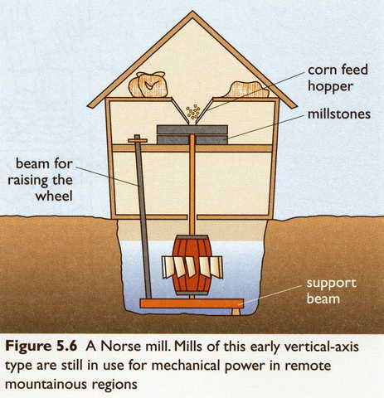
Water Mill

Slide 25
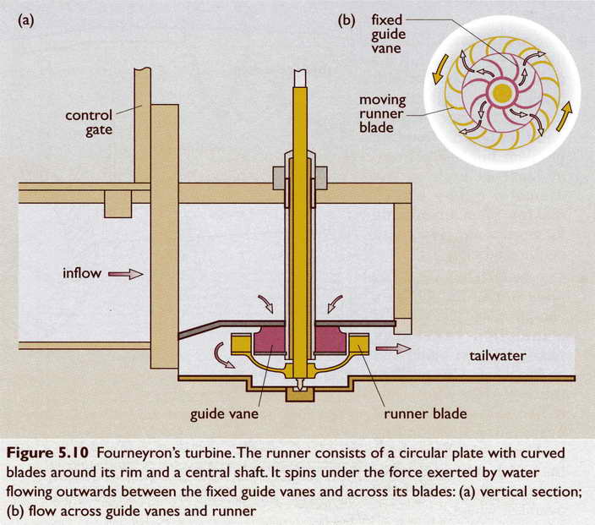
Turbine

Slide 26
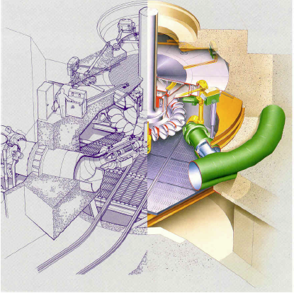
Pelton wheel

Slide 27
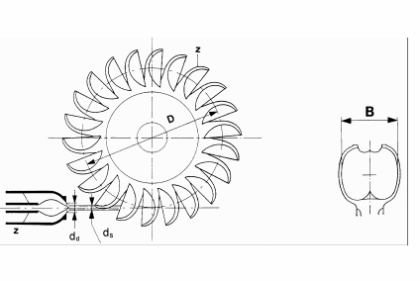
Components of Pelton wheel

Slide 28
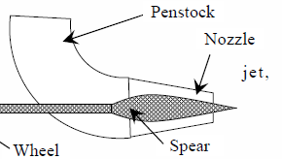

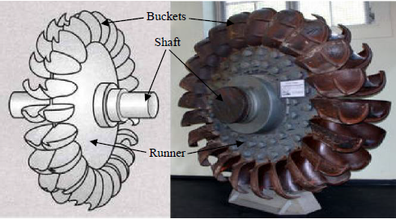
Components of Pelton wheel
The main components of a Pelton turbine are:
(i) Nozzle and flow regulating arrangement
(ii) Runner with buckets
(iii) Casing
(iv) Breaking jet

Slide 29
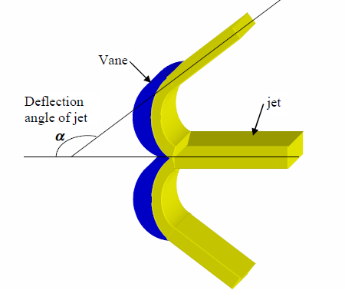
Pelton wheel Buckets

Slide 30
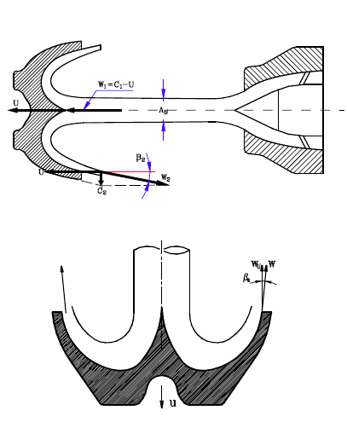
Pelton wheel Buckets

Slide 31
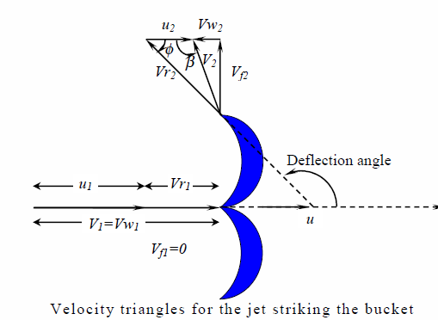
Velocity triangles for Pelton wheel

Slide 32


Power & Efficiency of a Pelton wheel
Work done per second by the jet on the vane = ƥaV₁[V_{w1}+ V_{w1}]u
Maximum efficiency

Slide 33
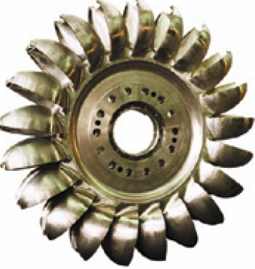
Problems
1.The head at the base of the nozzle of a Pelton wheel is 640 m. The outlet vane angle of the bucket is 15o. The relative velocity at the outlet is reduced by 15% due to friction along the vanes. If the discharge at outlet is without whirl find the ratio of bucket speed to the jet speed. If the jet diameter is 100 mm while the wheel diameter is 1.2 m, find the speed of the turbine in rpm, the force exerted by the jet on the wheel, the Power developed and the hydraulic efficiency. Take Cv=0.97.
2. A PELTON wheel turbine is having a mean runner diameter of 1.0 m and is running at 1000 rpm. The net head is 100.0 m. If the side clearance is 20° and discharge is 0.1 m3 /s, find the power available at the nozzle and hydraulic efficiency of the turbine.

Slide 34

Questions
1.Sketch the layout of a PELTON wheel turbine showing the details
of nozzle, buckets and wheel when the turbine axis is horizontal
2.Obtain an expression for maximum-efficiency of an impulse turbine.
3.With a neat sketch explain the layout of a hydro-electric plant
4.With a neat sketch explain the parts of an Impulse turbine
5.Classify the turbines based on head, specific speed and hydraulic
actions. Give examples for each.

